Slide 1
Enable inter-container communication
These slides are to be used in conjunction with the lab document.

Slide 2
LEARNING OBJECTIVE
Enable inter-container communication.

Slide 3
INTRODUCTION
This lab provides you with an example to enable inter-container communication in Docker.
We shall re-use the Book service which was deployed earlier and also deploy the python program* test_invoke_http.py (and invokes.py) which you have used in an earlier lab to invoke (communicate with) the Book service.
* We shall name this image - callbook
test_invoke_http
(invokes.py)
book
GET /book GET /book/<string:isbn13>
POST /book/<string:isbn13>

Slide 4
PREREQUISITES
Completed previous lab (4)

Slide 5
LAB OUTLINE
Preparation - obtain files for creating callbook image
Create Docker image - callbook:1.0
Configure networking and test

Slide 6
Create Docker image (callbook:1.0)
Create the image by entering below:
docker build -t <dockerid>/callbook:1.0 ./

Slide 7
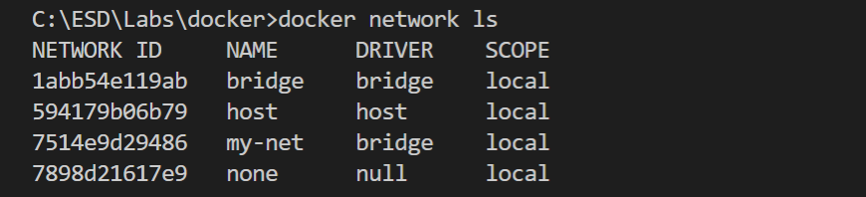
CONFIGURE NETWORKING AND TEST
docker network create my-net
docker network ls

Slide 8
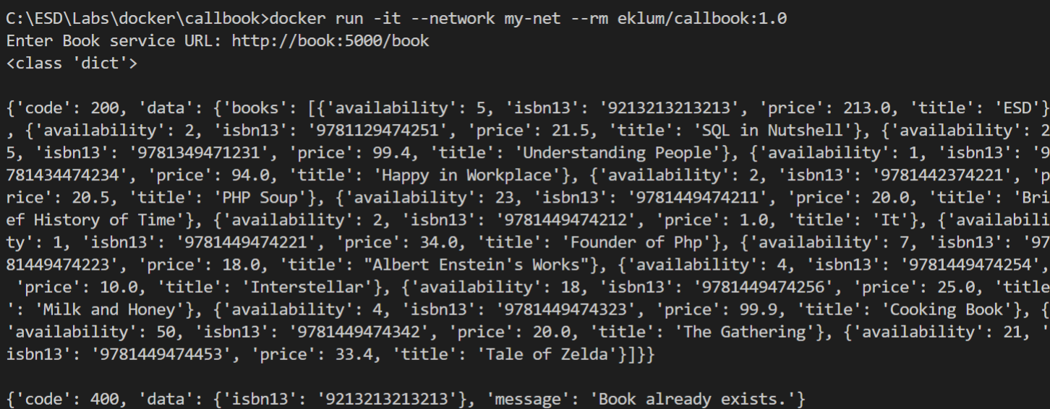
Test the services (Run the Containers)
Run book service:
docker run --name book --network my-net -e dbURL=mysql+mysqlconnector://is213@host.docker.internal:3306/book <dockerid>/book:1.0
Run callbook:
docker run -it --network my-net --rm <dockerid>/callbook:1.0
Notes:
Before running the book service: If you have not deleted the Book service containers created previously, delete the containers by entering the following commands in VS Code terminal:
docker ps -a
(-a to list all the containers; then)
docker rm -f <containerid1> <containerid2>

Slide 9
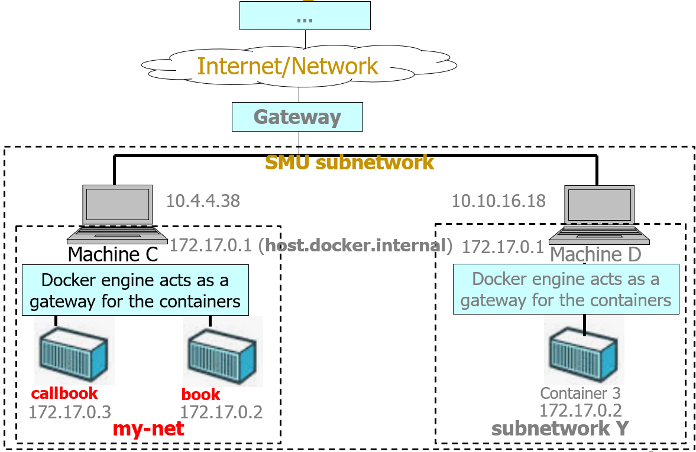
OVERVIEW
Notes:
Simplified networking diagram

Slide 10
LEARNING POINTS
Enable inter-container communication
Create, delete custom network
Work with Docker commands and options (docker run (--name, --network, -it, --rm options))

